Slide 1
Real-Time
Traffic
over the
Internet

Slide 2
CONTENTS
CHARACTERISTICS
RTP
RTCP

Slide 3
Example 1
An example of non-real-time multimedia traffic is the downloading of a video from the Internet. The video has already been made; it’s a finished product. A client HTTP is used to download the video from an HTTP server and the user views the video at a later time. The production, transmission, and use all happen at different times. Figure 28.2 shows this situation

Slide 4
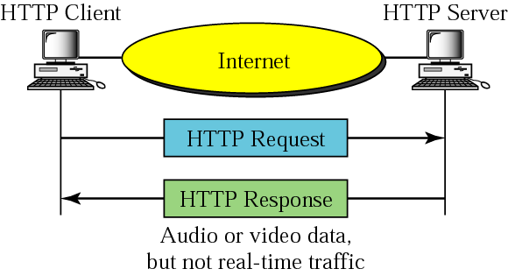
Figure 28-2
Non-real time multimedia traffic

Slide 5
Example 2
Now let us consider an example of real-time multimedia traffic. Consider a video conference in which a camera is connected to a server that transmits video information as it is produced. Everything that happens at the server site can be displayed on the computer at the client site. This is both multimedia (video) and real-time traffic (production and use at the same time). Figure 28.3 shows the situation.

Slide 6
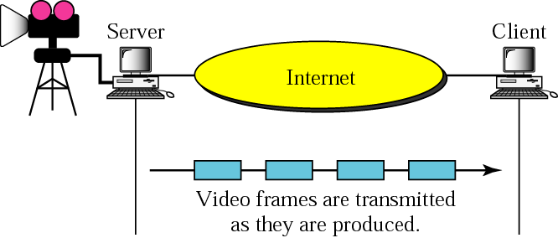
Figure 28-3
Real-time multimedia traffic

Slide 7
28.1
CHARACTERISTICS

Slide 8
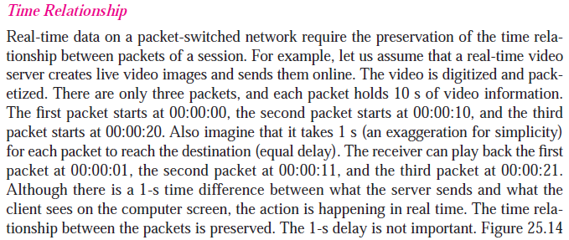

Slide 9
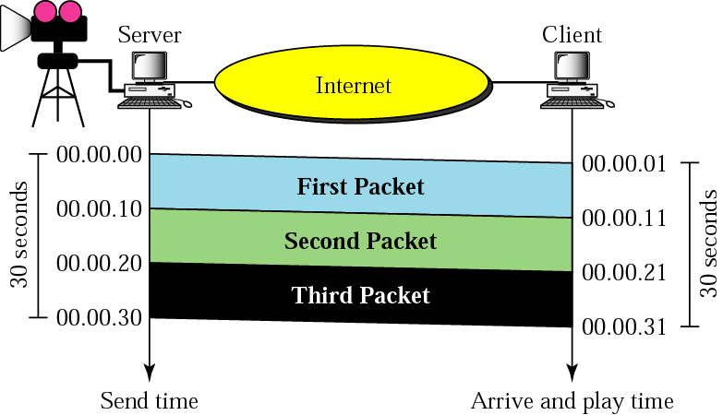
Figure 28-4
Time relationship

Slide 10
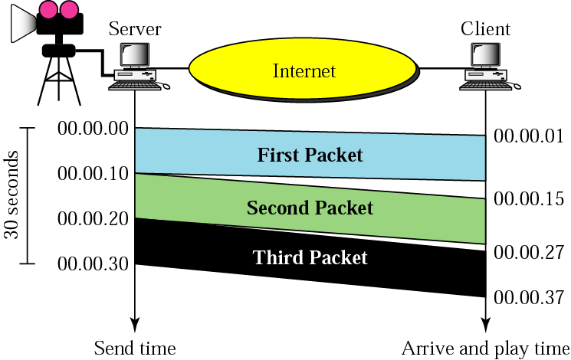
Figure 28-5
Jitter

Slide 11

Jitter is introduced in real-time
data by the
delay between packets.

Slide 12
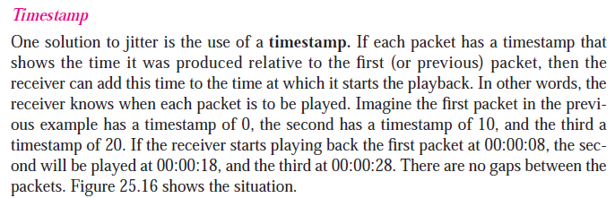

Slide 13
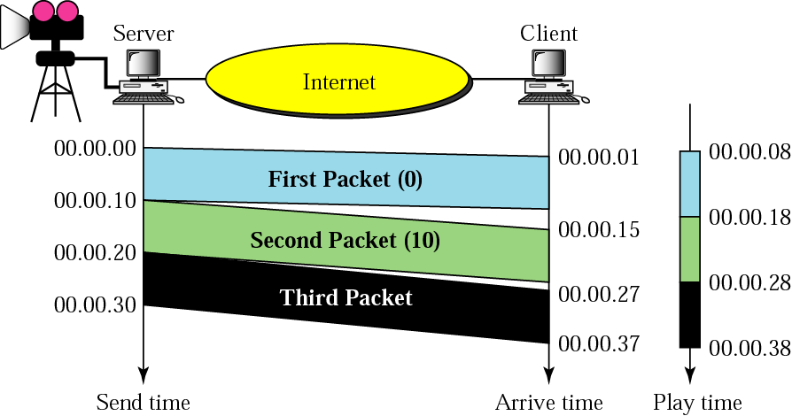
Figure 28-6
Timestamp

Slide 14
To prevent jitter,
we can timestamp the
packets and separate
the arrival time
from the playback time.

Slide 15
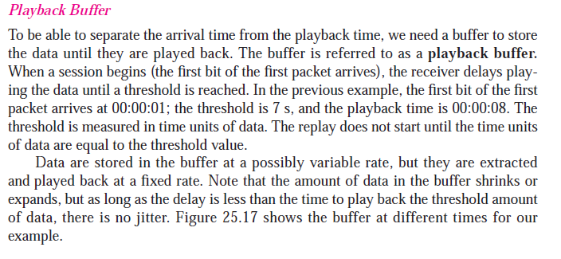

Slide 16
Figure 28-6
Timestamp

Slide 17
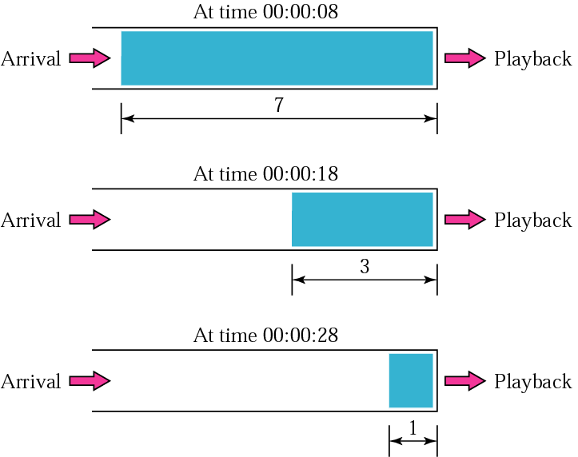
Figure 28-7
Playback buffer

Slide 18
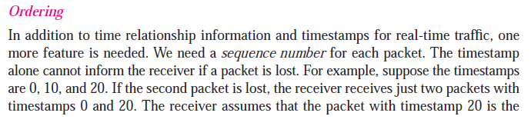


Slide 19
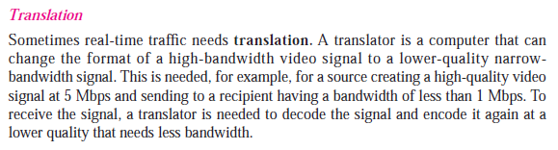

Slide 20
Translation means changing the
encoding of a payload to a lower
quality to match the bandwidth
of the receiving network.

Slide 21
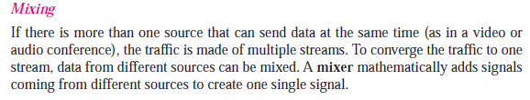

Slide 22
Mixing means combining
several streams of traffic
into one stream.

Slide 23
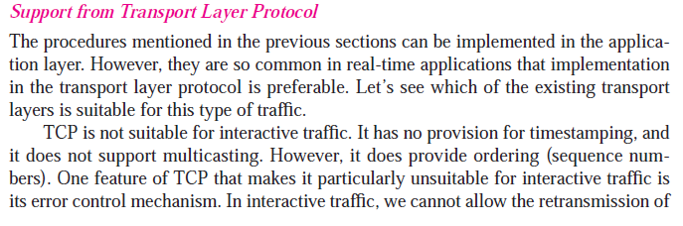
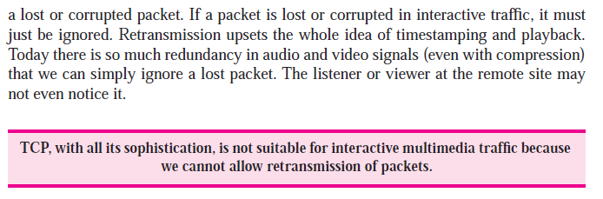

Slide 24
UDP in real time traffic
User Datagram Protocol or UDP is quite different. Unlike TCP, UDP is connectionless, which means that data packets can be sent without warning, preparation, or negotiation.
There’s no handshake or setup, just packets of data. UDP also lacks any kind of error control. Not only can packets be delivered in an incorrect order, but they can also get completely left out.
UDP is meant for applications where you are more concerned with keeping the stream of information going than making sure you receive every single packet. This makes UDP ideal for real-time services such as Voice over IP.

Slide 25
Why is UDP ideal for real-time services and not TCP?
It’s actually the ‘reliable’ nature of the protocol that hurts the end user experience. With TCP, delays happen every time there is an error like packet loss. These delays, which are caused by retransmitting packets, translate into an unacceptable level of jitter for the end user.
Luckily, real time communications services such as VoIP do not require a completely reliable transport layer protocol. This allows UDP to shine. Errors like packet loss usually only have minor impacts on the audio output. It is much better to drop a packet and have a few milliseconds of silence than to have seconds of lag.

Slide 26
TCP, with all its sophistication,
is not suitable
for real-time multimedia
traffic because
we cannot allow
retransmission of packets.

Slide 27
UDP is more suitable than
TCP for real-time traffic.
However, we need the services of
RTP, to make up the
deficiencies of UDP.

Slide 28
28.2
RTP

Slide 29
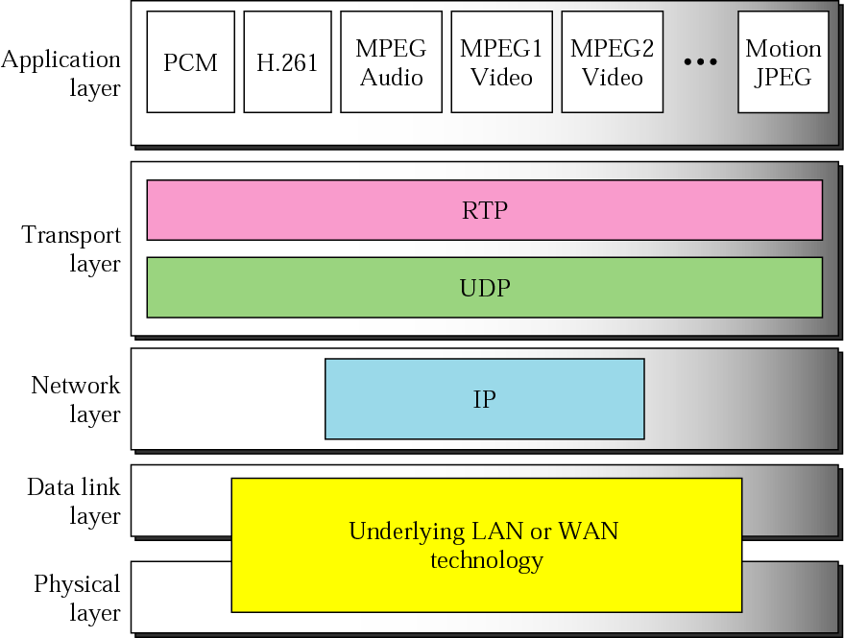
Figure 28-8
RTP

Slide 30
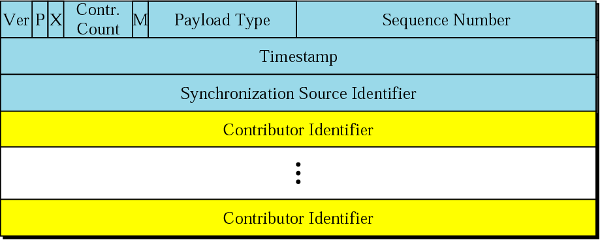
Figure 28-9
RTP packet header format

Slide 31
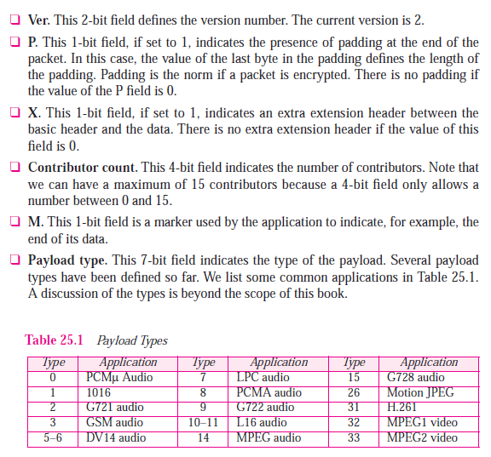

Slide 32
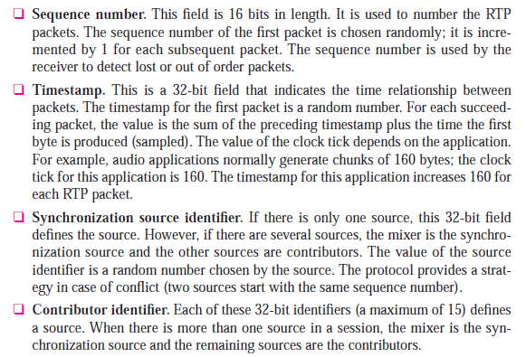

Slide 33
RTP uses
a temporary even-numbered
UDP port between 16384 -32767.

Slide 34
28.3
RTCP

Slide 35
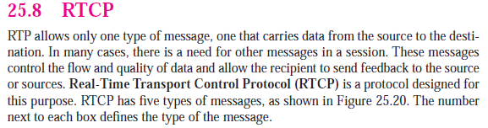

Slide 36
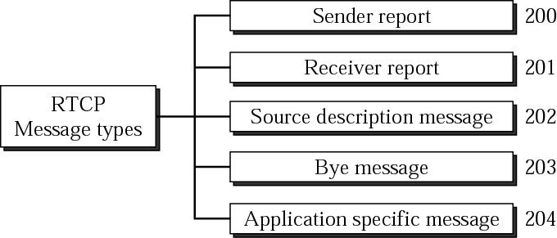
Figure 28-10
RTCP message types

Slide 37



Slide 38
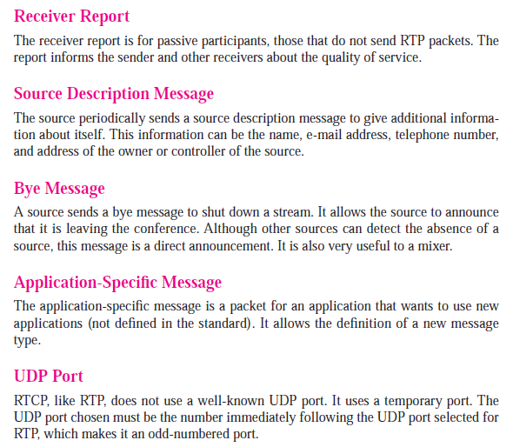

Slide 39
RTCP uses an odd-numbered UDP
port number that follows
the port number selected
for RTP.

